Slide 1
COMP20007 Design of Algorithms Semester 1 2016
NP-completeness
Or how to win a million dollars

Slide 2
Schedule for the rest of the semester
Today: NP completeness.
And the LMS student survey
Friday 20th: Guest lecture from Dr Matthias Petri
What to do with so much data you can’t store it all!
Tuesday 24th: Guest lecture from Dr Patrick Maes, ANZ CTO and GM Strategy & Planning for Global Technology, Services and Operations.
On whiteboard architectures
Fri 27th: wrap-up from Steven and me.
Summary:
lectures are examinable,
specifically set items of reading are examinable
Assignment content is examinable
“for interest / extra credit” things are not examinable
Workshops are not examinable

Slide 3
Lecture objectives
A quick overview of DPV chapter 8
Introduce the concepts of complexity classes P and NP
Introduce the concept of reducing one problem to another
Define NP-completeness
Introduce the Halting Problem

Slide 4
How to win a million dollars
http://www.claymath.org/millennium-problems/p-vs-np-problem
Is P = NP?

Slide 5
An “Efficient Algorithm”
Throughout this subject, “efficient” has meant O(n) or O(nlogn) or O(n²): a polynomial time algorithm.
Usually brute force methods have required O(2^{n}) or O(3^{n}) or O(n^{n}) or O(n!): exponential or factorial time.

Slide 6
Recall from lecture 1…
The size of a problem that is feasible using a polynomial time algorithm is much higher than an exponential
But computers keep getting faster and faster (Moore’s Law: processor speeds double every 18 months)
OK, let’s do a back of the envelope calculation
Take an old computer and a new computer
How many more inputs could we process?

Slide 7
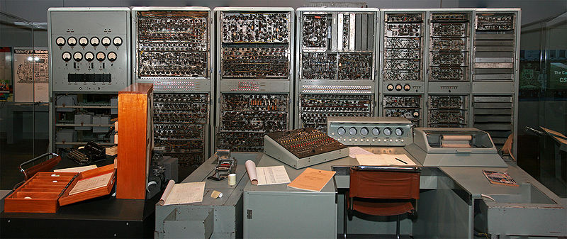
1949: CSIRAC – 1000 Hz

Slide 8

2013: IBM zEnterprise EC12 – 5.5 GHz

Slide 9
How many vertices/integers/edges/…
What “n” could you process in an hour?
So a 6 million times speed up in CPUs allows a factor of 6 million in the input…
 | CSIRAC | IBM EC12
O(n) | 3,600,000 | 21,260,088,115,200
O(n²) | 1,897
O(n³) | 153
O(2^{n}) | 21
O(3^{n}) | 14

Slide 10
How many vertices/integers/edges/…
What “n” could you process in an hour?
So a 6 million times speed up in CPUs allows a factor of 2449 in the input…
 | CSIRAC | IBM EC12
O(n) | 3,600,000 | 21,260,088,115,200
O(n²) | 1,897 | 4,610,866
O(n³) | 153
O(2^{n}) | 21
O(3^{n}) | 14

Slide 11
How many vertices/integers/edges/…
What “n” could you process in an hour?
So a 6 million times speed up in CPUs allows twice as many inputs for an exponential algorithm!
 | CSIRAC | IBM EC12
O(n) | 3,600,000 | 21,260,088,115,200
O(n²) | 1,897 | 4,610,866
O(n³) | 153 | 27,703
O(2^{n}) | 21 | 44
O(3^{n}) | 14 | 28

Slide 12
The moral of the story…
Algorithms rule the world! (and are fun)

Slide 13
Does every problem have a polynomial time algorithm?
This is a fundamental question in computer science
The answer is unknown!
We know that there are some problems that lots of smart people have thought about for a long time and have not been able to think of a polynomial time algorithm
Even better: there is a whole group of problems…

Slide 14
SAT
Given a boolean formula in conjunctive normal form (CNF), is there a truth assignment to the variables to make it true (to “satisfy” it)?
means “not x”.
means “or”.
(p)(q) means “p and q”
CNF – clauses “and” together, each clause is “or” of variable x or its negation
Eg
Is this formula satisfiable?
One has to be true from first clause
One has to be false from the final clause
But middle three says they all have to be the same

Slide 15
SAT (cont.)
So given a CNF formula with n variables, how long to search for a solution?
How many assignments of n boolean variables?
How long to check a single solution?
So SAT has an exponential number of solutions, but requires only polynomial time to check a solution.
Unfortunately, over the last 50 years, no one has come up with a polynomial time algorithm to solve SAT.

Slide 16
Travelling Salesman
Given a list of cities and the distances between each pair of cities, what is the shortest possible route that visits each city exactly once and returns to the origin city? [Wikipedia]
Obviously we model this as a…

Slide 17
Travelling Salesman
Given a list of cities and the distances between each pair of cities, what is the shortest possible route that visits each city exactly once and returns to the origin city? [Wikipedia]
Obviously we model this as a graph
4000
2600

Slide 18
TSP (cont.)
What is the tour (cycle) that visits every vertex exactly once and has minimum cost?
Alternately: given a budget b, is there a tour through the n vertices with cost b or less?
Huh, why convert a “shortest path” graph algorithm into a search algorithm? (Is it the same?)
If I give you a tour, how long does it take to verify if it is under budget?
How many possible tours are there?

Slide 19
TSP (cont.)
What is the tour (cycle) that visits every vertex exactly once and has minimum cost?
Alternately: given a budget b, is there a tour through the n vertices with cost b or less?
Huh, why convert a “shortest path” graph algorithm into a search algorithm?
If I give you a tour, how long does it take to verify if it is under budget? O(n)
How many possible tours are there?

Slide 20
TSP (cont.)
What is the tour (cycle) that visits every vertex exactly once and has minimum cost?
Alternately: given a budget b, is there a tour through the n vertices with cost b or less?
Huh, why convert a “shortest path” graph algorithm into a search algorithm?
If I give you a tour, how long does it take to verify if it is under budget? O(n)
How many possible tours are there? O(n!)

Slide 21
TSP (cont.)
What is the tour (cycle) that visits every vertex exactly once and has minimum cost?
Alternately: given a budget b, is there a tour through the n vertices with cost b or less?
Huh, why convert a “shortest path” graph algorithm into a search algorithm?
If I give you a tour, how long does it take to verify if it is under budget? O(n)
How many possible tours are there? O(n!)
This reminds me of SAT: exponential search space, but polynomial time to verify a solution…

Slide 22
The class of problems P and NP
A problem is said to be in class NP if, given some input I and a proposed solution S, you can verify whether S is a correct solution in polynomial time in the size of I. (A decision or search problem.)
NP = Nondeterministic Polynomial time
That is, a problem in this class can be solved by an algorithm that nondeterministically (magically? with an oracle? fortuitously?) chooses the correct S, and then verifies it.
If there is a (deterministic) polynomial time algorithm for finding the solution, then the problem is also in class P.

Slide 23
All of the problems we have done are in NP
But not all of them are in P...
Knapsack had running time O(nW) and W is not necessarily polynomial in n

Slide 24
Reduction
A reduction from a search problem A to a search problem B consists of two polynomial time algorithms
f, which maps the input of A to the input of B
h, which maps the output of B to the output of A

Slide 25
NP-complete
A problem is NP-complete if it is in NP and all other problems in NP can be reduced to it.
Thus if one NP-complete problem could be solved in polynomial time, we would know P=NP.
Surprisingly, there are quite a few NP-complete problems, which leads people to believe that P ≠ NP

Slide 26
What to do when employer asks you to solve an NP-complete problem?
Hope n is small
Use an approximation (eg Set Cover)
Use a search technique and hope for the best
Branch and bound
Backtracking
Read DPV Chapter 9.

Slide 27
Even worse…
Write an algorithm that will solve a given polynomial equation with integer solutions (Diophantine equation). (Hilbert’s 10th problem)
eg
x³yz + x²y⁴z² -7xy⁵z = 6
Write an algorithm that tells me if program P with integer I will terminate? (Halting problem)
wikipedia: List_of_undecidable_problems

Slide 28
Summary
There are problems which can have a proposed solution verified in polynomial time (class NP)
Some of these also have polynomial time algorithms to find the solution (class P)
A subset of NP problems reduce to each other, and none have polynomial time algorithms (class NP-Complete)
It seems unlikely that P = NP, but who knows?
http://www.claymath.org/millennium/
There are problems for which no known algorithm exists of any time complexity!
(see COMP30025 Theory of Computation)

